Slide 1
Module 4: Closing the gap, Part 1: Using evidence of learning to adjust instruction and better meet students’ needs
Micro-Course 1:
Learning Acceleration Using Formative Assessment Processes in the Classroom (Introductory Version)
This work is licensed under a Creative Commons Attribution 4.0 International License. Educators and others may use or adapt. If modified, please attribute and re-title.
Version 1.0 | Updated October 2021 | Developed By: Carla Evans & Jeri Thompson National Center for the Improvement of Educational Assessment

Slide 2
Warm Up
What instructional strategies have you used or know about to help close the gap between where students are now in their learning and where they need to go?

Slide 3
Formative Assessment Processes:
The Bridge Between Teaching and Learning
Formative assessment is a process that is inseparable from instruction.
Evidence of student learning strengths/needs is gathered through formative assessment processes and used to adjust instruction to better meet students’ needs.
Teaching
Formative Assessment Processes
Learning

Slide 4
Module Outline
Step 1: Collect evidence of student learning strengths/needs before, during, and/or after instruction in relation to unit learning goals and lesson targets (see Modules 2-3)
Step 2: Analyze student work using quick sorts
Step 3: Adjust instruction using flexible grouping strategies and feedback mechanisms
Step 4: Repeat
1
Collect
3
2
Adjust
Analyze

Slide 5
Step 2:
Analyze Student Work Using Quick Sorts
Use evidence of student learning collected before, during, or after instruction
Sort the student work or observations into three groups:
What is the evidence of developing understanding that can be built upon?
What issues or concerns are evidenced in the student work?
Group 1 | Group 2 | Group 3
This group of students does not appear to understand the key concept or skill that is the focus of the lesson and connected to the unit big idea | This group of students demonstrates some understanding of the key concept or skill that is the focus of the lesson and connected to the unit big idea, but needs some re-teaching or additional elaboration to clarify conceptual understanding, misconceptions, or procedural/practical errors | This group of students demonstrates complete understanding of the key concept or skills that is the focus of the lesson and connected to the unit big idea

Slide 6
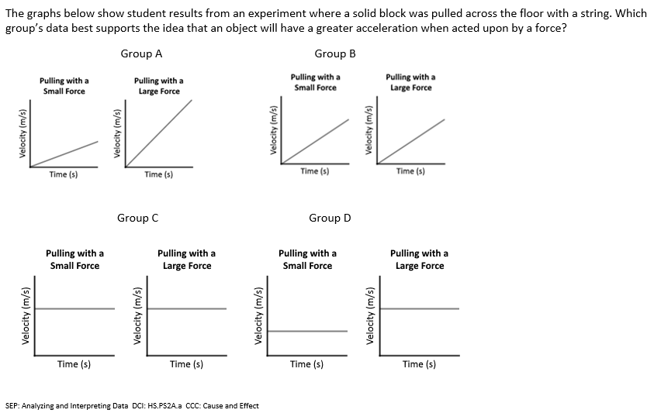
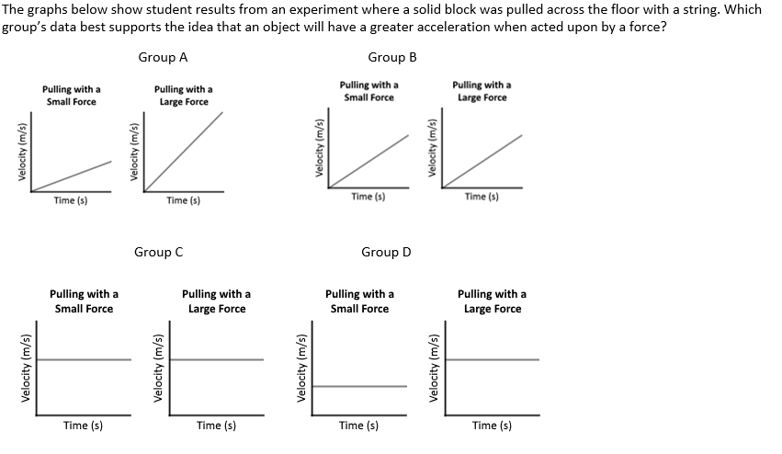
High School Physical Science Pre-Assessment Example
Goals of the Lesson | Pre-Assessment Question | Predictable Instruction Implications
Analyze data to support the claim that Newton’s second law of motion describes the mathematical relationship among the net force on a macroscopic object, its mass, and its acceleration (HS-PS2-1) |  | Student work could be sorted into three piles that will lead into differentiated instruction (flexible grouping) for this lesson: Students who did not select the correct answer Students who selected the correct answer, but were not able to explain using Newton’s second law of motion Students who both selected the correct answer and explained fully
Select the correct answer and explain your reasoning.

Slide 7
Step 3:
Adjust instruction using flexible grouping strategies
What are all the ways you can think of to group students in your classroom?
Independent or individual
Pairs
Small groups (more similar or less similar learning strengths/needs)
Whole group

Slide 8
Flexible Groups
Instead of belonging to static groups, group membership is fluid or dynamic, changing to meet the different strengths and needs of the students.
Teachers might make group assignments based on the results of analyzing student work using quick sorts
Alternatively, students might choose to work in a particular group based on their interests or learning strengths/needs.
Flexible grouping offers students the opportunity to work with classmates who are either similar or quite different in skill levels or interests.

Slide 9
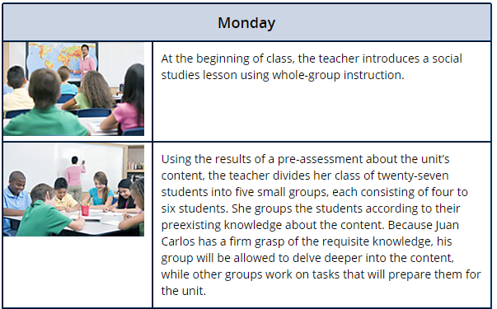
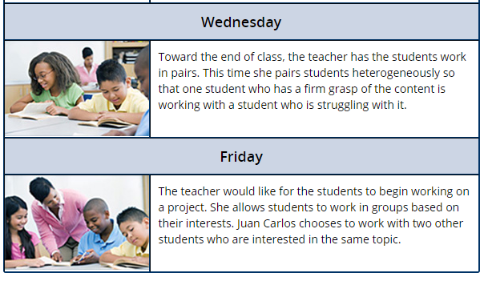
Example of Flexible Grouping
https://iris.peabody.vanderbilt.edu/module/di/cresource/q1/p02/#content

Slide 10
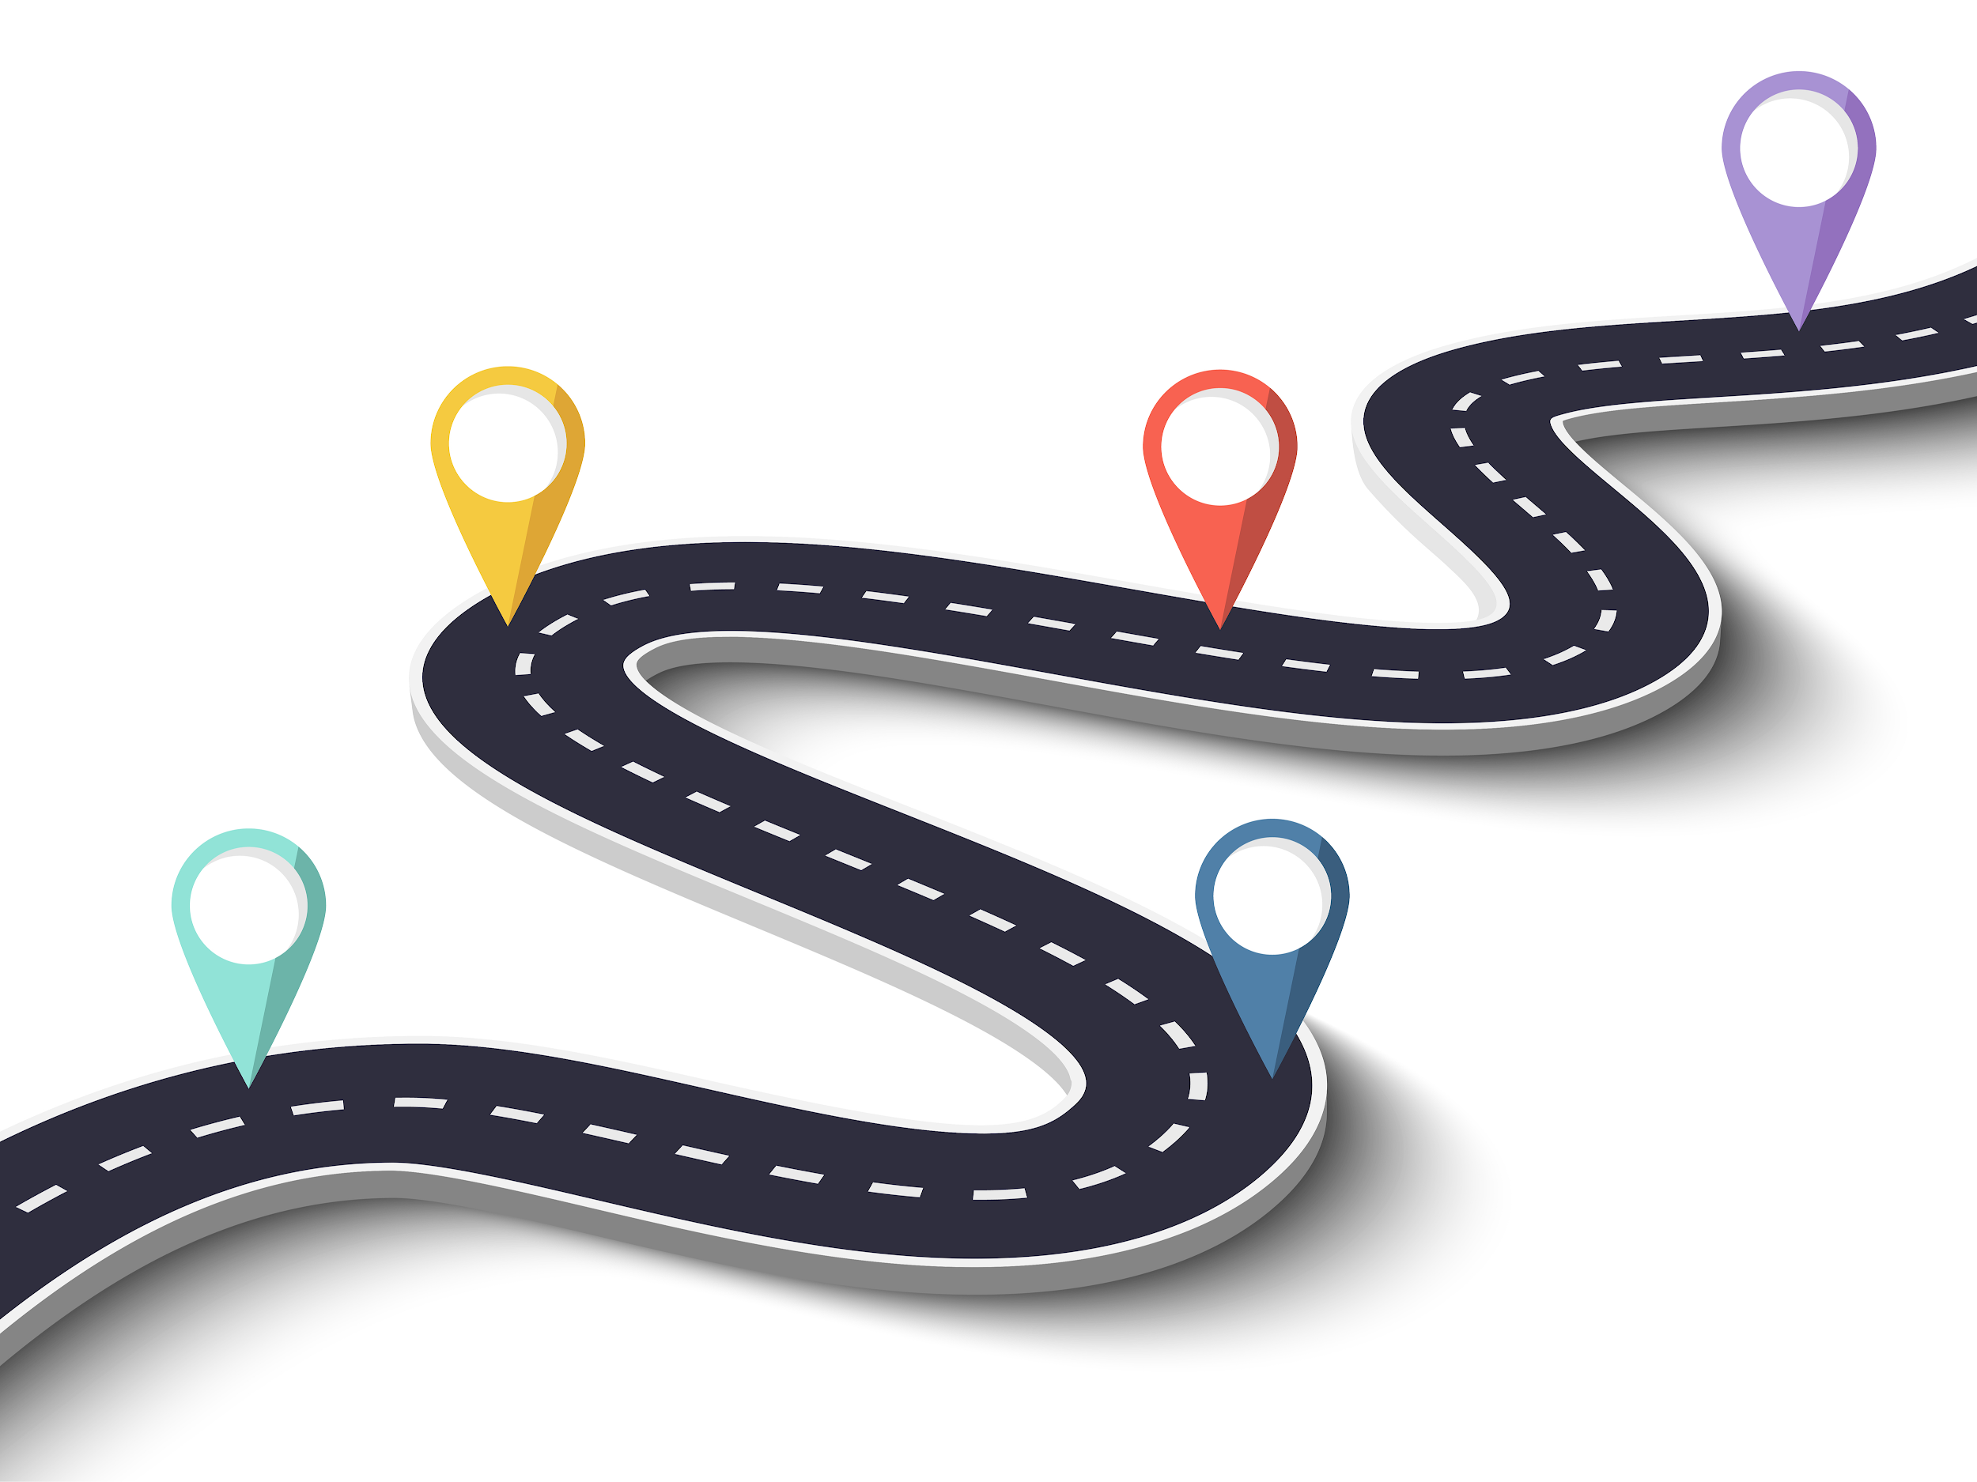
Step 3:
Adjust instruction using feedback
Feedback from the teacher, peers, or the student themselves supports accelerated learning or closing the distance/gap between where a student is currently and where they need to go.
Learning Targets or Goals
Student 3
Student 1
Student 2

Slide 11
Characteristics of Useful Formative Feedback
Think about some area of learning or performance you have tried to improve in your life (e.g., cooking, writing, teaching, playing the piano, etc.).
What type of feedback was most useful to you to support improvement and growth?
Related to the learning targets and success criteria
Actionable, descriptive, specific, and timely
Just right for the student (not to far out ahead, not too far behind)
www.nciea.org

Slide 12
Feedback from the Teacher
Flexible Grouping Strategy | Feedback Mechanism Example
Independent or individual | Teacher to student feedback in 1:1 conference
Pairs or Small groups (more similar or less similar learning strengths/needs) | Teacher to student feedback in small group setting (math) or small group setting (ELA) Teacher-led small group instruction (notice how the teacher is coaching students and focusing on the different needs of the group; some are ready and moving ahead; others need more instruction)
Whole group | Teacher feedback during whole group instruction/discussions

Slide 13
Feedback from Peers
Flexible Grouping Strategy | Feedback Mechanism Example
Pairs | Pairs (notice how the two students are working together to solve a problem)
Small groups (more similar learning strengths/needs) | Student-led small group discussions (notice where students are sharing different perspectives and coming to consensus)
Small groups (less similar learning strengths/needs) | Student-led small group discussions (notice how the students are re-teaching and helping their peers)

Slide 14
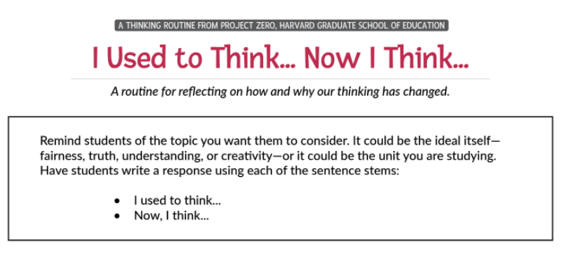
Feedback from Self
Flexible Grouping Strategy | Feedback Mechanism Example
Independent or individual | Student self reflection in relation to learning target (the exit ticket was a self-reflection)

Slide 15
Final Thoughts
The goal is to help all students demonstrate grade level proficiency expectations by the end of the year.
Some students will need more intensive interventions and supports within and outside of the classroom.
Some students will need enrichment.
You’ll need to use professional judgment and conversations with other teachers to decide what knowledge, skills, and understandings are most critical in your content area and grade level. These content standards should be where you focus on closing gaps.

Slide 16
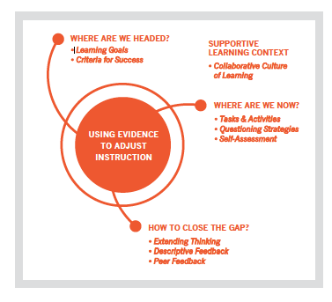
Review
Module 1
Overview: Formative assessment processes and learning acceleration (Introduction)
Module 2
Where the learner is now, Part 1: Using quick pre-assessments to elicit evidence of student strengths and learning needs
Module 3
Where the learner is now, Part 2: Using formative assessments during or after instruction to elicit evidence of student strengths and learning needs
Module 4
Closing the gap, Part 1: Using evidence of learning to adjust instruction and better meet students’ needs

Slide 17
Reflection Questions
Describe the four steps involved in helping to close the gap between where learners are and where they need to go?
Consider an upcoming lesson. How can you collect evidence of student learning before, during and/or after instruction?
Describe how you could sort the resulting student work, observations, or discussions into three groups to adjust instruction. If you collected the actual evidence of student learning, do the quick sort rather than describe it.
Explain how you can use flexible grouping strategies and feedback (from teacher, peer, and/or student) to close learning gaps and accelerate learning.
What is one key takeaway and one lingering question you have after listening to this module?

