Slide 1
Module 1: Formative Assessment Processes and Learning Acceleration (Advanced)
Micro-Course 2:
Learning Acceleration Using Formative Assessment Processes in the Classroom (Advanced Version)
This work is licensed under a Creative Commons Attribution 4.0 International License. Educators and others may use or adapt. If modified, please attribute and re-title.
Version 1.0 | Updated January 2022 | Developed By: Carla Evans & Jeri Thompson National Center for the Improvement of Educational Assessment

Slide 2
Warm-Up
What are the first words that come to mind when you think of the words
“formative assessment”?

Slide 3
Defining Formative Assessment Process
“…a planned, ongoing process used by all students and teachers during learning and teaching to elicit and use evidence of student learning to improve student understanding of intended disciplinary learning outcomes and support students to become self-directed learners.”
Council of Chief State School Officers (2018, p. 2). Revising the Definition of Formative Assessment. Retrieved from https://ccsso.org/resource-library/revising-definition-formative-assessment

Slide 4
Two Main Types of Classroom Assessment Processes
 | Summative Classroom Assessments | Formative Classroom Assessments
Purpose | Document student achievement of state content standards at a point in time (assessment of learning) | Elicit evidence of student learning to adjust teaching and learning to better meet students’ needs (assessment for learning)
Administration | Typically administered at the end of a unit of instruction | On-going; occurs before, during, and after instruction
Feedback Mechanisms | Graded and reported to parents and students | Not graded; feedback shared with students

Slide 5
Misconception Alert
Assessments are not formative or summative by design, they are formative or summative based on use.
The same exit ticket, quiz, test, or performance task can be used summatively or formatively (as long as student thinking is made visible and students are involved in the process).

Slide 6
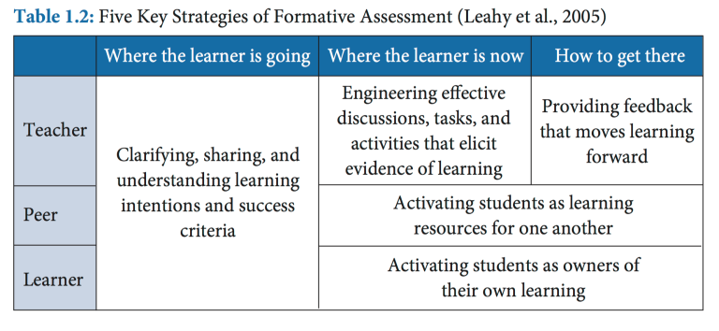
Embedded Formative Assessment Strategies
Wiliam, D. (2018). Embedded formative assessment, 2nd ed. Bloomington, IN: Solution Tree Press.

Slide 7
Embedded Formative Assessment Strategies
Big Idea:
“Evidence about student learning is used to adjust instruction to better meet students’ needs. In other words, teaching is adaptive to the learner’s needs.”
Wiliam, D. (2018). Embedded formative assessment, 2nd ed. Bloomington, IN: Solution Tree Press.

Slide 8
Connection to Learning Acceleration
End of Unit
Learning Goals

Slide 9
Learning Intentions & Success Criteria
The learning goals, sometimes called “learning targets,” should be aligned to and derived from the broader curricular goals and state standards.
What will my students be trying to learn? What does success, or hitting the target, look like?
Make sure students are aware of what they are trying to learn and the success criteria.

Slide 10
Elicit Evidence of Student Learning
There’s both the for what purpose and how components of eliciting evidence of student learning for formative purposes.
Identify student learning strengths/needs before, during, and/or after instruction.
Inform future instruction and differentiated instruction by making student thinking visible.
Engineer effective classroom discussions, tasks, activities, and observations.
Formative assessment practices that can be plugged into any curriculum:
60 Formative Assessment Techniques
Formative Assessment Classroom Protocols and Strategies

Slide 11
Misconception Alert
Formative assessment data has no appropriate use in student evaluation such as student grades.
Numerous studies have shown that when students see a grade on their paper along with comments, they only look at the grade.
Grading can also have harmful effects on student motivation and future learning.
Notes:
As Dylan Wiliam’s says: “As soon as students get the grade, the learning stops” (p. 146).

Slide 12
Feedback that Moves Learning Forward
The Quality & Type of Feedback
The Source of Feedback
The Purpose of Feedback
Related to the learning targets and success criteria.
Actionable, descriptive, and specific.
Appropriate to the student’s zone of proximal development (i.e., Goldilocks principle--not too far out ahead, not too far behind, but just right)
Teacher
Student Self-Assessment
Peer
Inform instruction (monitor and adapt)
Adjust student learning goals
Motivate and improve student learning

Slide 13
Peers as Learning Resources
Students must work interdependently, not divide and conquer (group goals)
Individuals must be held accountable for their contributions
Collaborative Learning
Students become the teacher in small group settings
Reciprocal Teaching
Students are not grading/evaluating each others work, but providing feedback that helps their peers improve the quality of their work
Peer Assessment
“You never really understand something until you try to teach it to someone else.”(Wiliam, 2018, p. 166)

Slide 14
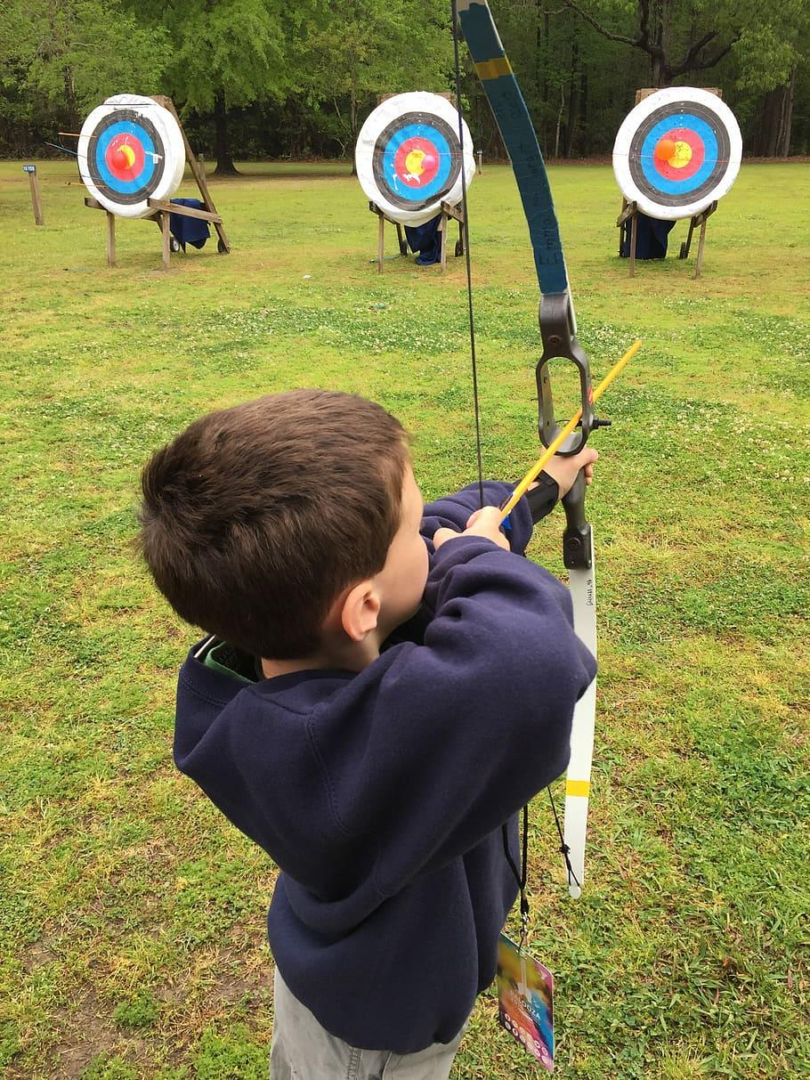
Students as Owners of their own Learning
“For students to be actively involved in their learning, they must understand a learning goal, aim for it, and use assessment evidence along the way to stay on course” (p. 3).
Three formative assessment questions:
Where am I going?
Where am I now?
What do I need to do next?
Connected to self-regulated learning (e.g., metacognition and motivation)
Brookhart, S., & Lazarus, S. (2017). Formative assessment for students with disabilities. Washington, DC: Council of Chief State School Officers.

Slide 15
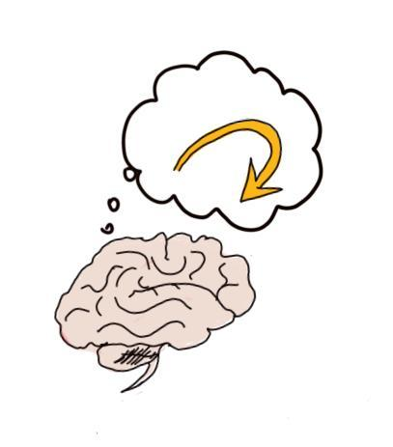
Metacognition
Metacognition, or “thinking about one’s own thinking,” is the internal dialogue taking place in the mind of a learner.
Teachers support students as active agents in this process when they think-aloud and model for students what they are thinking so students can hear their internal dialogue and internalize that process for themselves over time.

Slide 16
Examples of Aligned Teacher Practices
There are many ways a teacher can demonstrate these formative assessment strategies.
The follow resource provides a set of rubrics that qualitatively describe what a teacher might do along a continuum related to each formative assessment process:
Rubrics for the implementation formative assessment processes (pages 37-71)

Slide 17
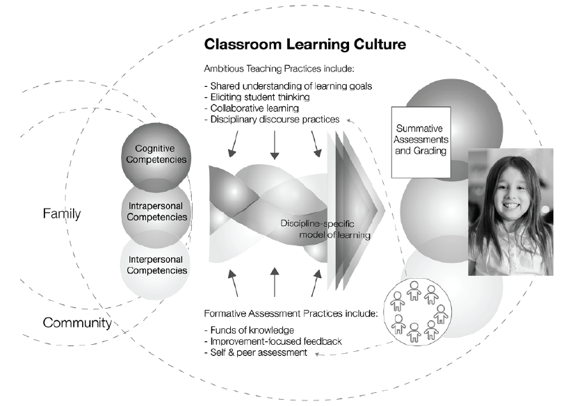
Remembering the Systems Component
Formative assessment processes operate within a classroom assessment and instructional system.
d
Shepard, L. A. (2019). Classroom assessment to support teaching and learning. In The Annals of the American Academy of Political and Social Science (pp. 183–200). Retrieved from https://doi.org/10.1177%2F0002716219843818

Slide 18
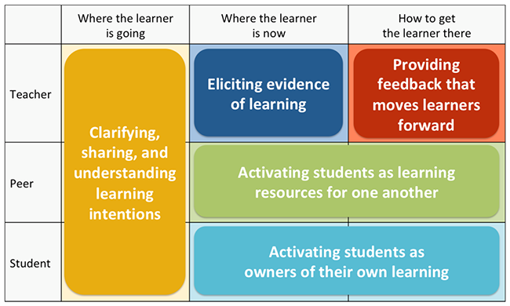
Going Deeper: Micro-Course 2
Module 1
Overview: Formative assessment processes and learning acceleration (Advanced)
Module 2
Where the learner is going: Clarifying, sharing, and understanding learning intentions and success criteria
Module 3
How to get there: Providing feedback that moves student learning forward
Module 4
Closing the gap, Part 2: Involving students and their peers in the formative assessment process

Slide 19
Reflection Questions
Create a web or concept map that explains the formative assessment process.
Describe a couple ways in which your formative assessment practices could shift as a result of listening to this module .
Think about an area of performance you tried to improve in recent years (e.g., writing, cooking, etc.). What type of feedback contributed to your improved performance? How does that relate to what was discussed in this module with respect to the quality and type of feedback that is more/less useful?
Explain how formative assessment processes operate within a classroom assessment and instructional system.
What is one key takeaway and one lingering question you have after listening to this module?

Slide 20
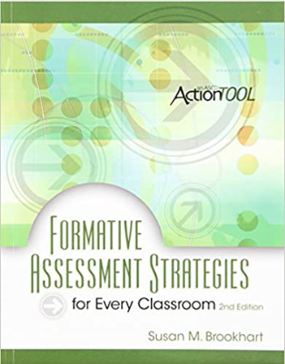
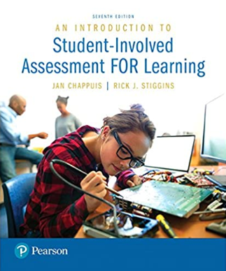
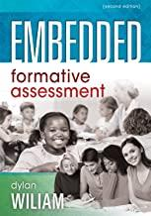
For Additional Reading…

