Slide 1
Module 4: Formative Assessment: Supporting teachers as they involve students and their peers in the formative assessment process
Micro-Course 3:
Supporting teachers to accelerate learning using formative assessment processes in the classroom
This work is licensed under a Creative Commons Attribution 4.0 International License. Educators and others may use or adapt. If modified, please attribute and re-title.
Version 1.0 | Updated January 2022 | Developed By: Carla Evans & Jeri Thompson National Center for the Improvement of Educational Assessment

Slide 2
Warm-up
List at least two self-assessment and two peer-assessment strategies that you could look for when conducting brief walk throughs or more formal teacher observations.

Slide 3
Formative Assessment Process
“…a planned, ongoing process used by all students and teachers during learning and teaching to elicit and use evidence of student learning to improve student understanding of intended disciplinary learning outcomes and support students to become self-directed learners.”
Council of Chief State School Officers (2018, p. 2). Revising the Definition of Formative Assessment. Retrieved from https://ccsso.org/resource-library/revising-definition-formative-assessment

Slide 4
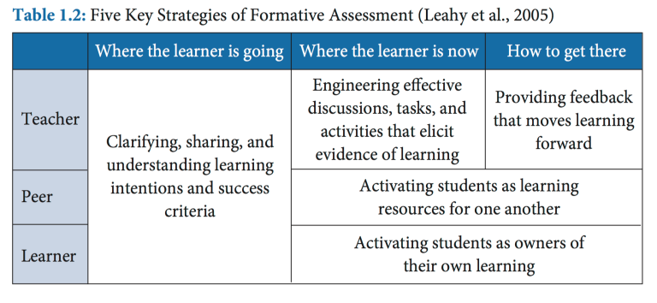
Going Deeper: Formative Self- and Peer-Assessment

Slide 5
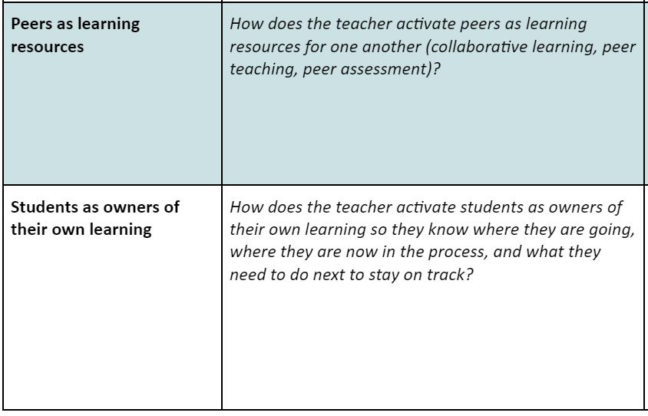
Formative Assessment Process Discussion Tool
In this module, school leaders will examine self- and peer-assessment in more detail in ways aligned to the teacher module.
The goal is to help school leaders support the implementation and change process around these practices in their schools and districts.

Slide 6
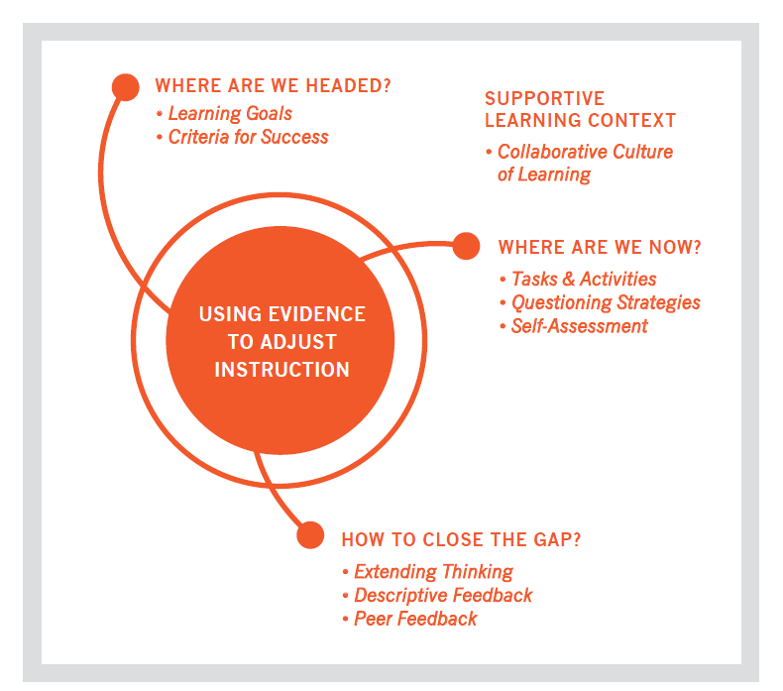
Students as Owners of Their Own Learning
Where am I going or what are the goals? At this point students must understand the learning target and success criteria.
Where am I now or what progress is being made toward the goal? This requires ongoing formative assessment including self- and peer-assessment. And
What do I need to do next or what activities need to be undertaken to make better progress? In order for students to close the gap between the intended and current learning, instructional adaptations are made by the teacher and learning adjustments are made by the student.

Slide 7
Goal Setting
Metacognitive Lenses:
What I know
What I can do
What I know about my own cognitive abilities
What I have learned from previous experiences
Self- assessment questions:
Where am I going?
Where am I now?
What do I need to do next?
Consider a goal that you have created for yourself. How have you considered the self-assessment questions and the metacognitive lenses when you created this goal?

Slide 8
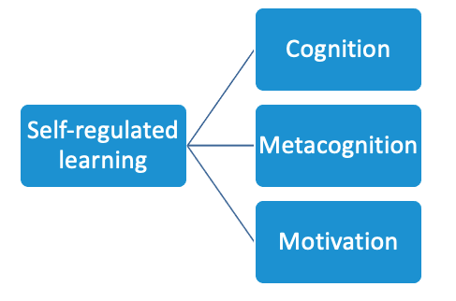
Self-Regulated Learners

Slide 9
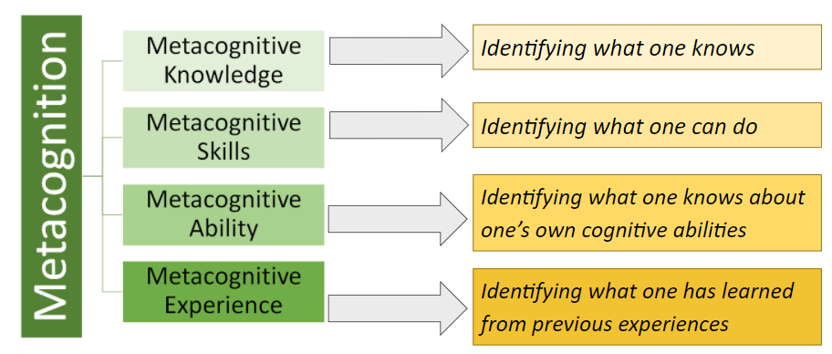
Self-Regulated Learners

Slide 10
Self-Assessment
...a formative assessment process in which students:
practice applying concepts and skills
recognize the successful characteristics of concepts and skills in their work
translate judgments into action plans for improvement
Andrade, H., Huff, K., & Brooke, G. Assessing Learning: A blend of practices can create a balanced, student centered assessment system. (2012) Education Digest.

Slide 11
Formative Self-Assessment
Right click on the image to open the hyperlink and watch a 5-minute video on self-assessment or use the hyperlink below.
https://www.youtube.com/watch?v=CkFWbC91PXQ&t=1s

Slide 12
Strategies/Tools for Formative Self-Assessment
Strategies for self-assessment range from those that focus on one particular lesson, assignment, or topic to those that are more broad and encompass self-assessment over a period of time (e.g., end of unit, end of the school year, etc.)
A couple broad self-assessment strategies include:
reflective journaling where students are asked to think back on their learning growth and progress over a specified amount of time
students gathering work to put into a portfolio intended to demonstrate growth or achievement and share their reflections with their parents during student-led conferences

Slide 13
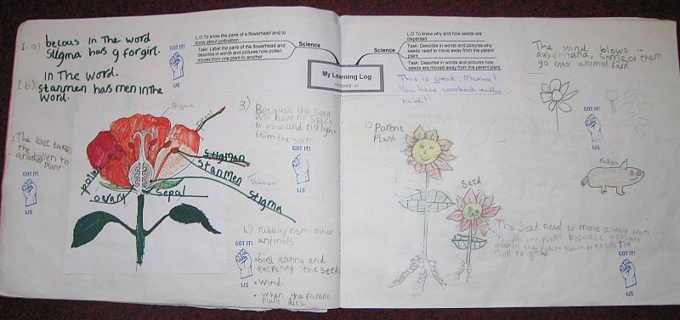
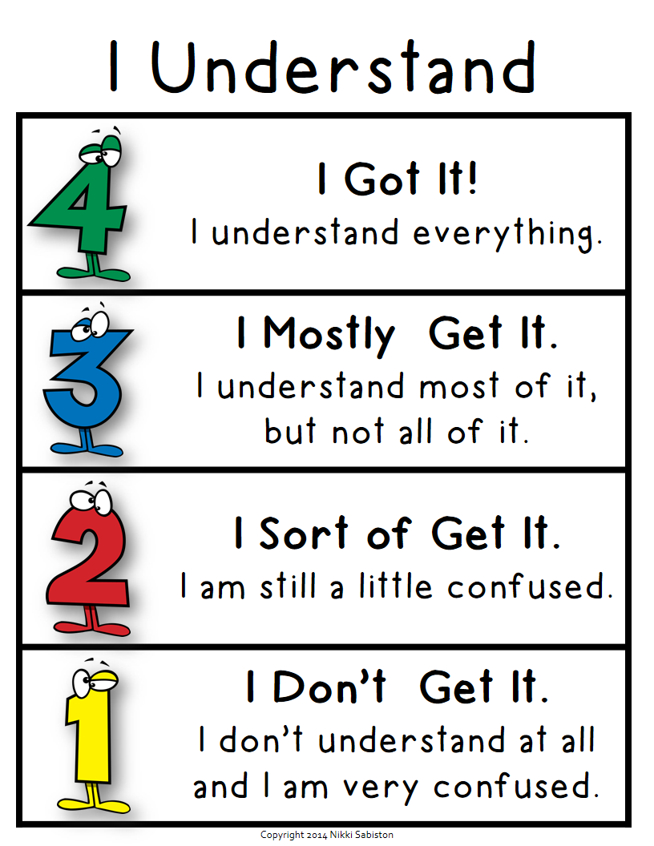
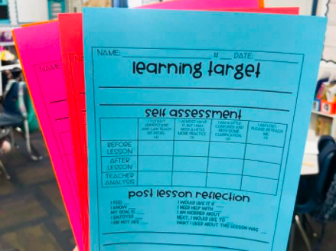
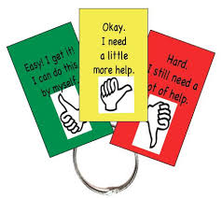
Strategies/Tools for Formative Self-Assessment
Example self-assessment tools: Checking work against success criteria with highlights | Traffic light code | Reflection: I used to think, now I think | Two stars and a wish | What happened, what’s next reflection

Slide 14
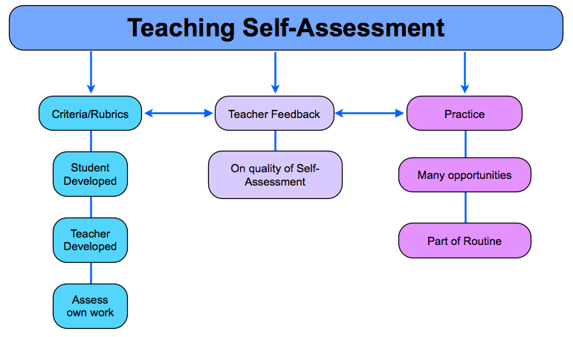
Effective Formative Self-Assessment
Does the student…
accurately identify strengths and weaknesses
internalize the self-assessment process
evaluate their own work regularly
set goals and monitor their progress
ask questions
see mistakes as opportunities for learning

Slide 15
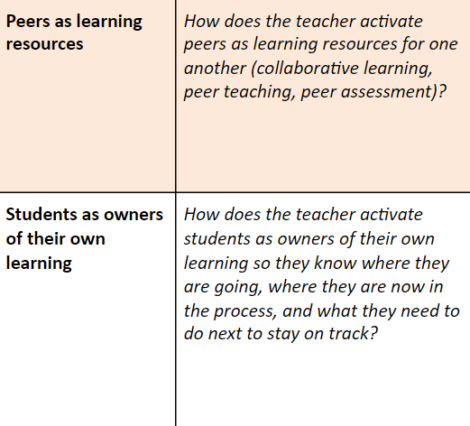
Identifying ‘Look Fors’ & Supporting Best Practices
Take a few minutes and identify what you could look for related to formative self-assessment as you do walk throughs or observe teaching in your school or district.
Then try it out. What did you notice after conducting brief walk throughs? What types of resources, conversations, or others supports might teachers need to build their professional practice in this area? How can you support that development?

Slide 16
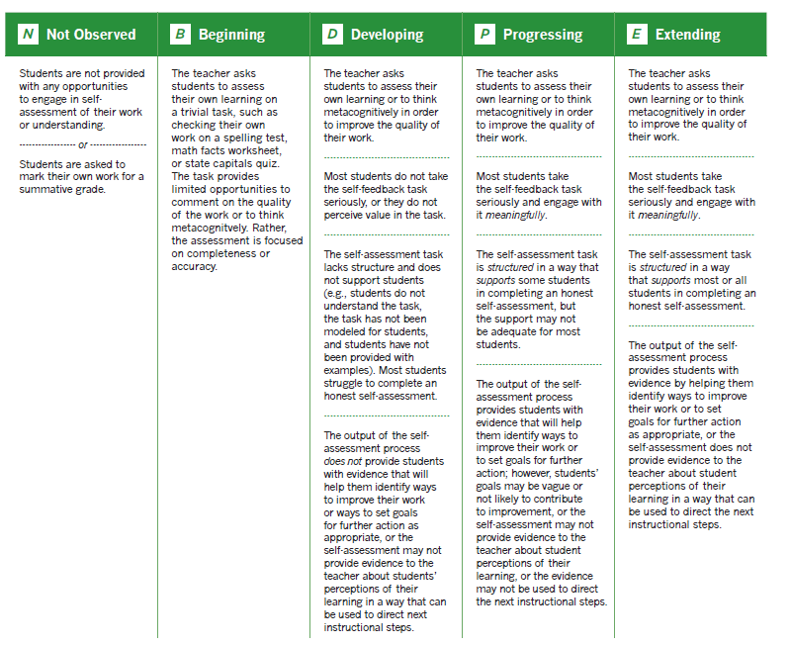
Using the Formative Assessment Rubrics, Reflection and Observation Tools to Support Professional Reflection on Practice (Revised)
See Self Assessment (pages 64-66) in the following document:
Using the Formative Assessment Rubrics, Reflection and Observation Tools to Support Professional Reflection on Practice: Rubrics for the implementation of formative assessment processes

Slide 17
Peer Feedback
“Research shows that the people providing the feedback benefit just as much as the recipient because they are forced to internalize the learning intentions and success criteria in the context of someone else’s work, which is less emotionally charged than one’s own.”
Wiliam, D. (2006). Does assessment hinder learning? Paper presented at ETS International Seminar, p.5

Slide 18
Peer Feedback: A secondary presentation example…
Success Criteria:
Introduce your topic in a way that engages your audience
Appeal to pathos (emotion), logos (logic), and/or ethos (credibility)
Use a combination of visuals and multimedia to reinforce important points
Provide an ending that provides a call to action
Starting your speech with an imagined “what if” scenario was a good way of getting the audience’s attention and set the tone for the rest of the speech. I think that the ending could have been strengthened if you returned to the scenario when you had your call to action. By the end of the speech, I had forgotten why you had this call to action. Your visuals were really helpful as you made each of your points and they really appealed to my emotions.

Slide 19
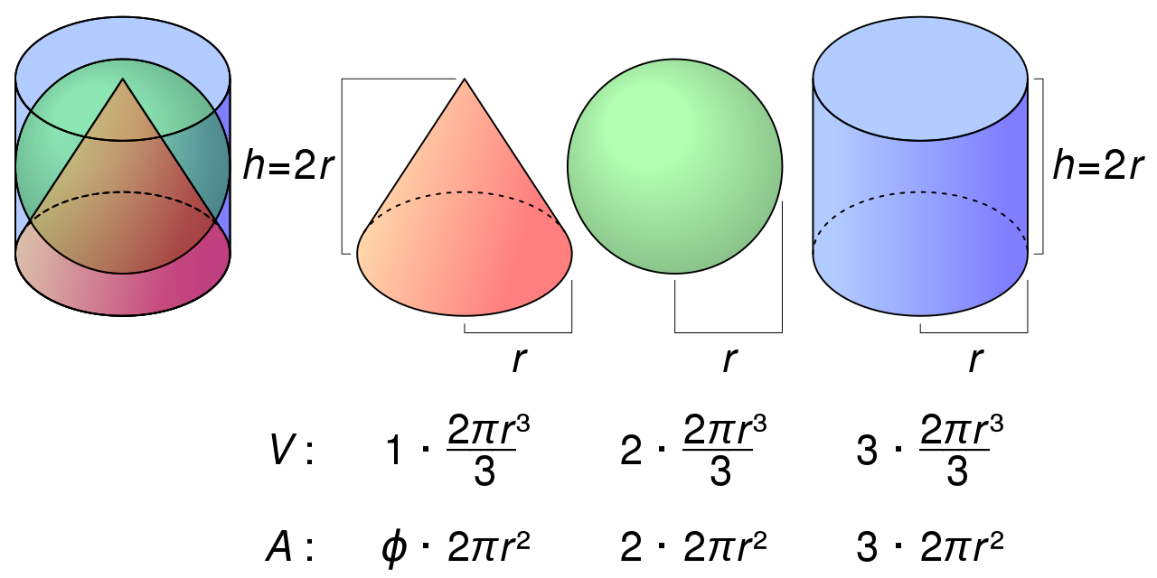
Peer Feedback: A secondary math example…
Success Criteria:
I can explain what it means to find the volume of a solid figure and how volume is measured.
I can find the volume of cylinders, pyramids, cones, and spheres by using formulas.
I can solve real-world math problems using my understanding of volume.
We noticed you correctly identified the formulas for cylinders, pyramid, cones, and spheres, but when you went to apply the formulas in the context of the real-world math problem you seemed to have a hard time applying the correct formulas. Consider breaking the complex figure into distinct solid figures first and then applying the formulas. We use our pencil to draw over the complex figure to help visualize the different solid figures within the complex figure.

Slide 20
Peer Feedback: An elementary science example…
Success Criteria:
Explain what you want to measure and what tools will be used
Identify the key variable and factors that are controlled and held constant
Make predictions about what would happen if a variable changes
Your design shows that you know what you are going to measure as time. You’ve identified the control variable as the height that you will drop the feather and the tested variable as the size of the feather. But we’re not clear about your predictions of what will happen with changing the size of the feather. Can you provide a prediction with an explanation?

Slide 21
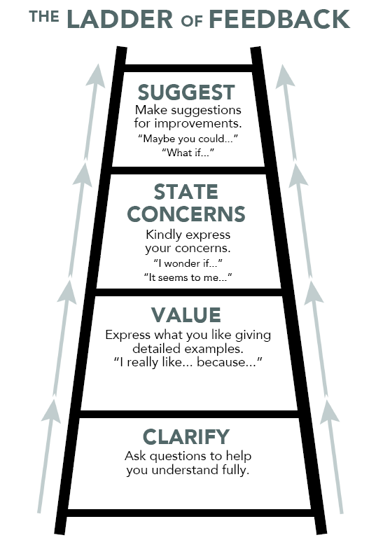
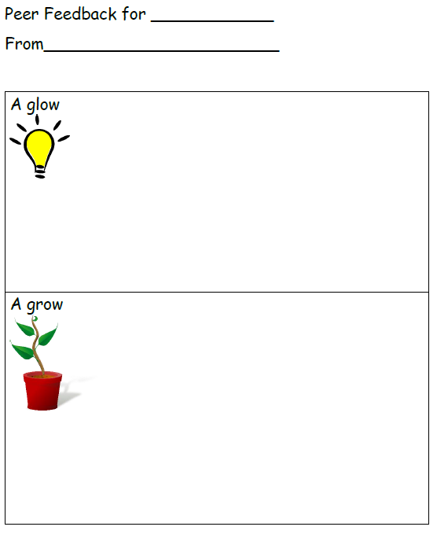
Peer Feedback Tools
Example peer assessment tools: Ladder of Feedback | Prompts | Sentence Starters | Glow & Grow

Slide 22
Strategies for Instruction
Sentence Starters:
“Have you thought about …?”
“I wasn’t clear what you meant when you said…”
Model… Model… Model along with think-alouds
Fishbowl

Slide 23
Identifying ‘Look Fors’ & Supporting Best Practices
Take a few minutes and identify what you could look for related to formative peer-assessment as you do walk throughs or observe teaching in your school or district.
Then try it out. What did you notice after conducting brief walk throughs? What types of resources, conversations, or others supports might teachers need to build their professional practice in this area? How can you support that development?

Slide 24
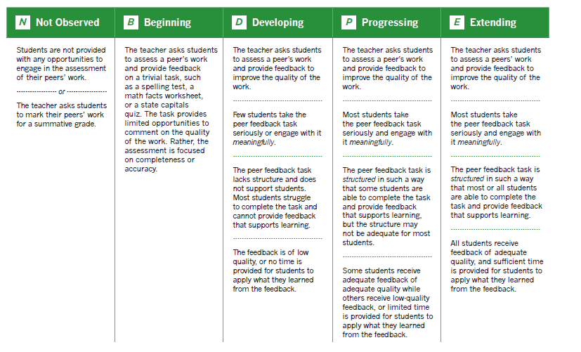
Using the Formative Assessment Rubrics, Reflection and Observation Tools to Support Professional Reflection on Practice (Revised)
See Peer Feedback (pages 60-62) in the following document:
Using the Formative Assessment Rubrics, Reflection and Observation Tools to Support Professional Reflection on Practice: Rubrics for the implementation of formative assessment processes

Slide 25
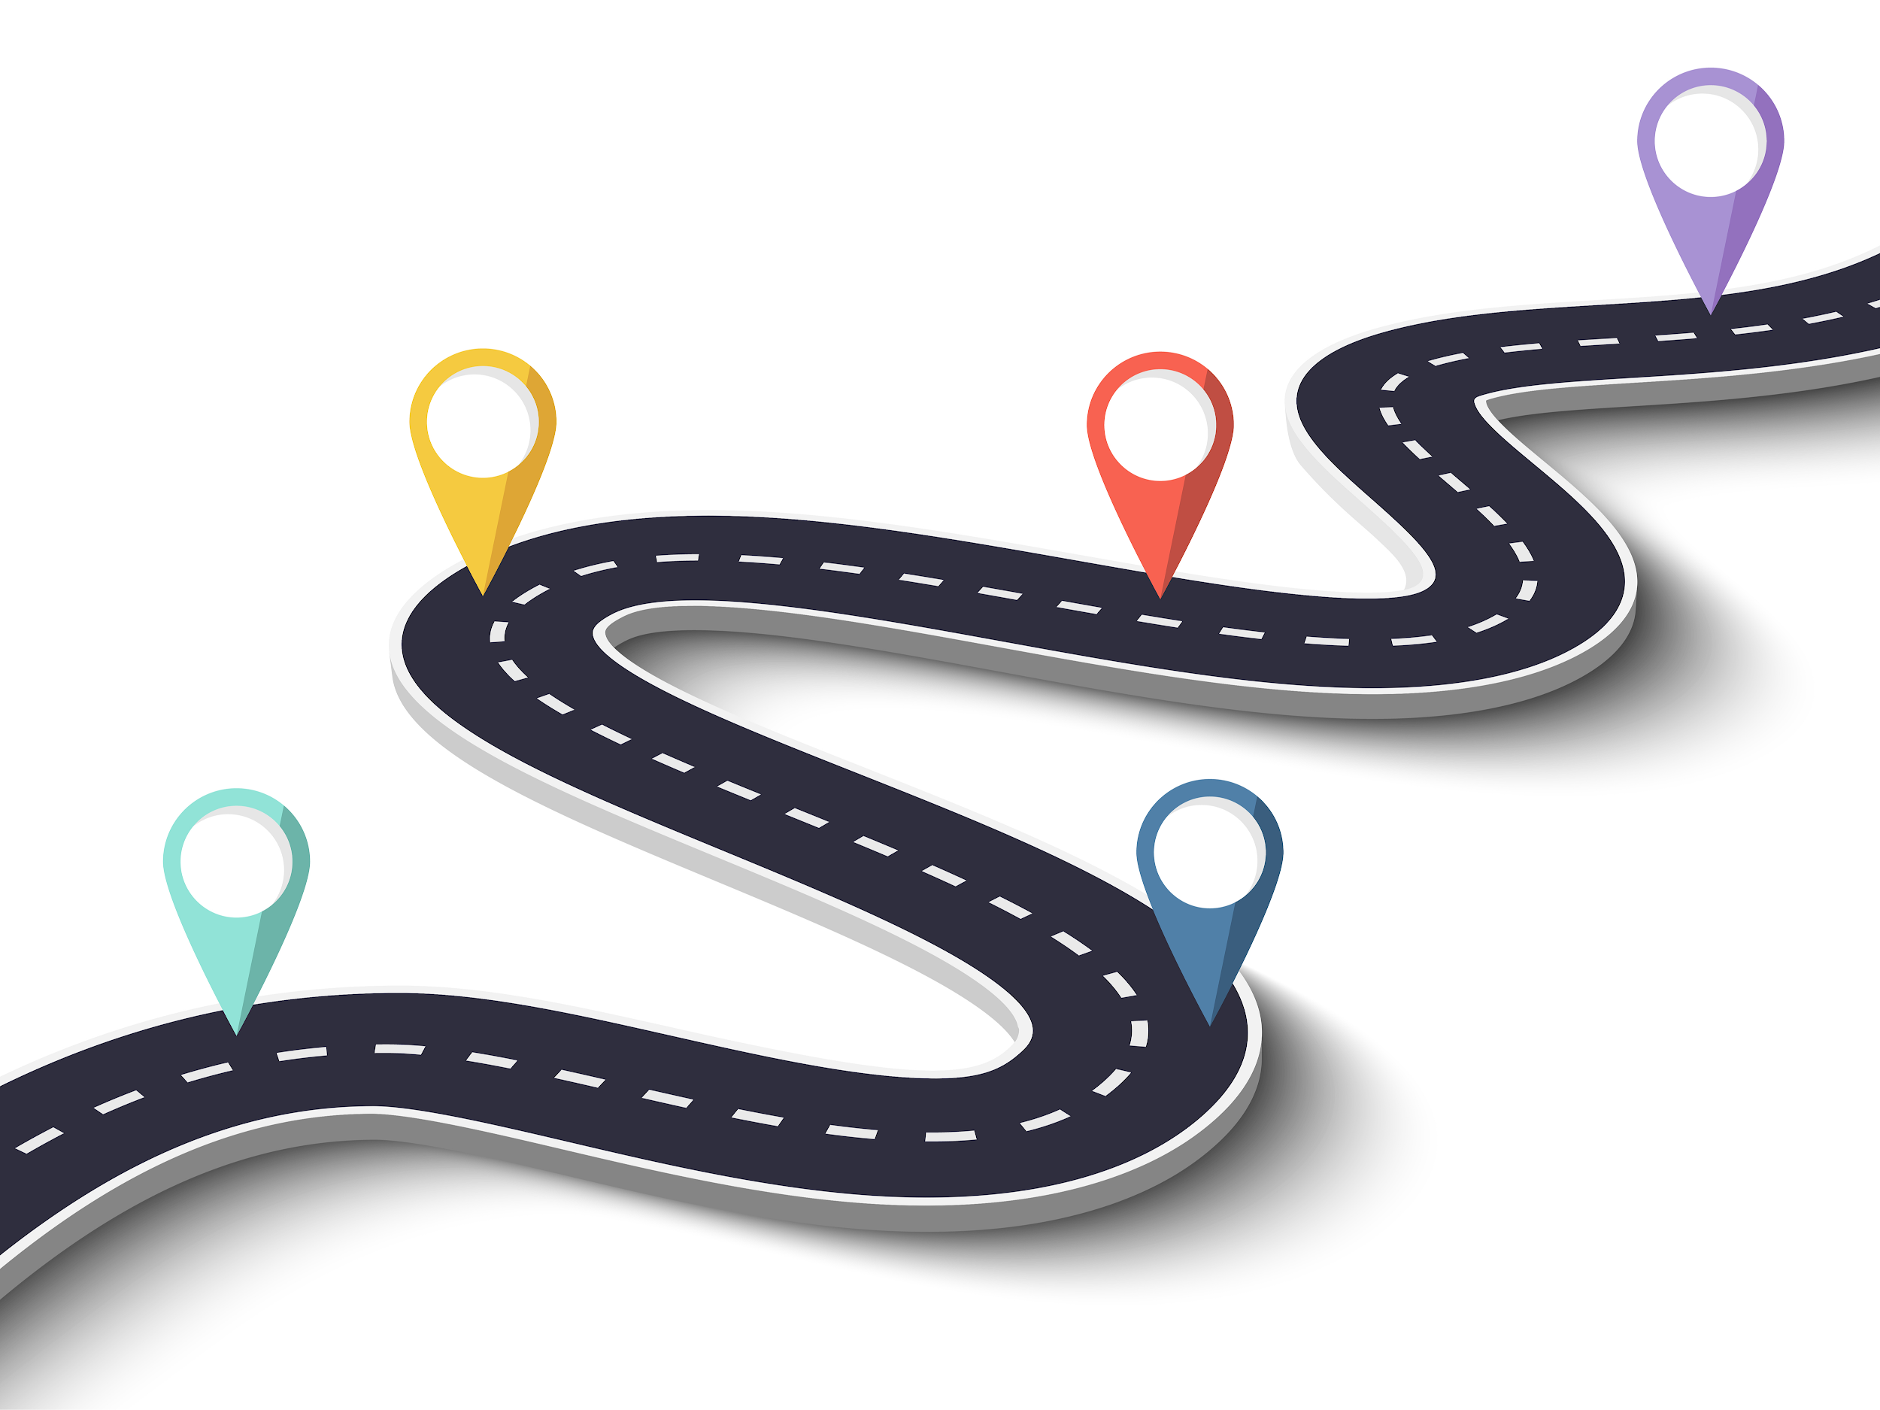
Micro-Course 3 Outline
Module 1
Accelerating Learning: Supporting high-quality formative assessments in the classroom
Module 2
Accelerating Learning: High-quality discussions between school leaders and teachers about formative assessment processes
Module 3
Accelerating Learning: Supporting teachers as they create or select formative assessments during or after instruction
Module 4
Accelerating Learning: Supporting teachers as they involve students and their peers in the formative assessment process
Module 4
Module 2
Module 3
Introduction
Module 1

Slide 26
Reflection Questions
Describe the benefits of self- and peer-assessments as part of the formative assessment process.
Conduct brief walk throughs or observe teaching for self-assessment or peer-assessment. What did you notice? What did you learn? What do you wonder about?
Based on what we discussed in this module and your prior knowledge, what are some additional ways that students can learn how to self- or peer-assess their work?
Explain the role of self-regulation and metacognition in self- and peer-assessments.
What is one key takeaway and one lingering question you have after listening to this module?

