Slide 1
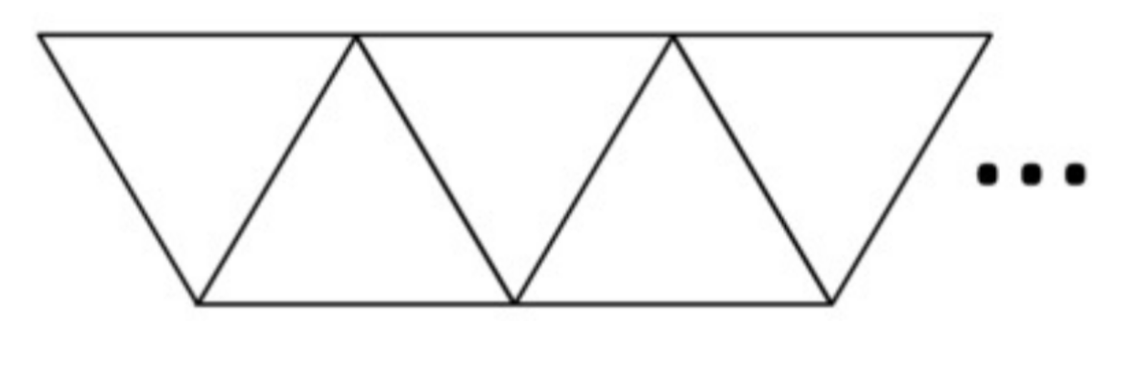
A classroom has triangular tables. They can be arranged like this. How many students can sit around 1 table? 2 tables? X tables?

Slide 2
A classroom has triangular tables. They can be arranged like this:

Slide 3
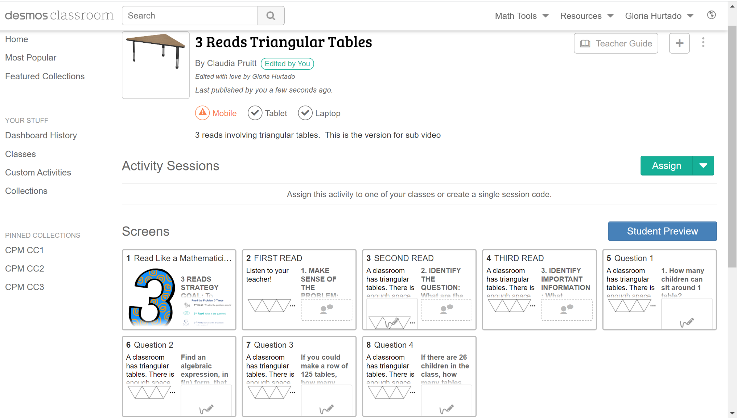

Slide 4
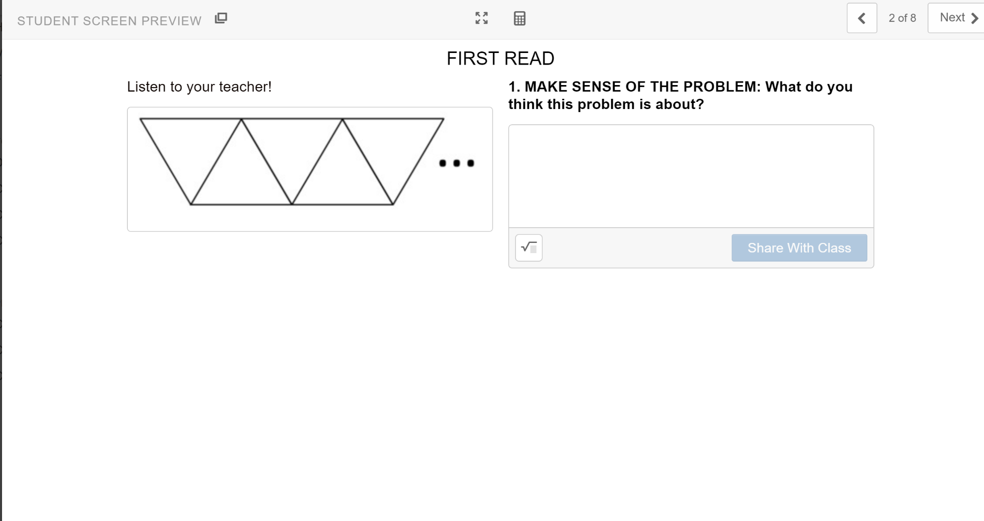

Slide 5
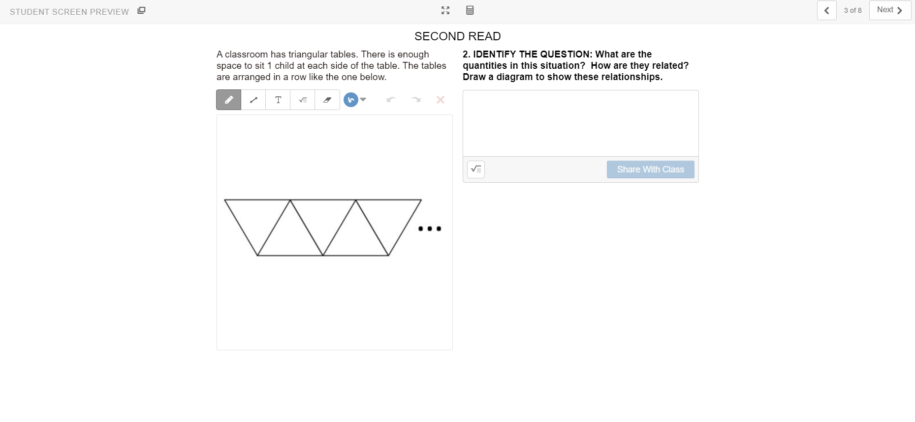

Slide 6
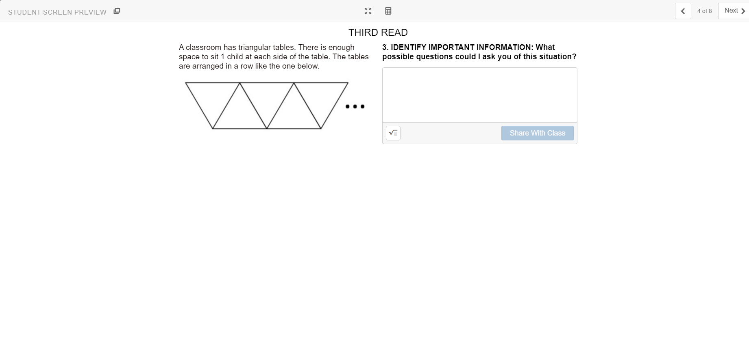

Slide 7
A classroom has triangular tables. They can be arranged like this. How many students can sit around 1 table? 2 tables? X tables?

