Slide 1
Writing Fluency

Slide 2
Writing Fluency
The Smarter Balanced assessment requires students to type at length on demand. The must respond to a complex prompt that necessitates reading and synthesis of multiple documents, including videos, articles, and graphs. Students must wrestle with the task of generating ideas about an unfamiliar topic, organize their responses, and writing an essay quickly with minimal errors. The greatest obstacles for students with these type of on-demand writing tasks is their own inability to generate enough writing to use for crafting and/or organizing an essay and enough writing stamina to complete it.
-Educational Weekly Blogger Ryan McCarty

Slide 3
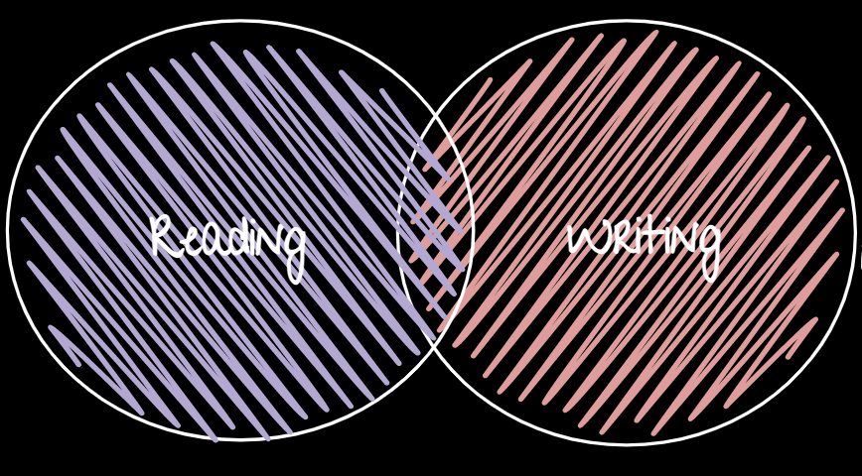
Readers who don’t read fluently devote much of their cognitive energy to decoding individual words and phrases, making it difficult for them to focus on the meaning of what they read.
Similarly, students lacking writing fluency devote lots of cognitive energy to forming individual words or basic sentence structures, making it harder for them to focus on conveying their thoughts and feelings effectively.

Slide 4
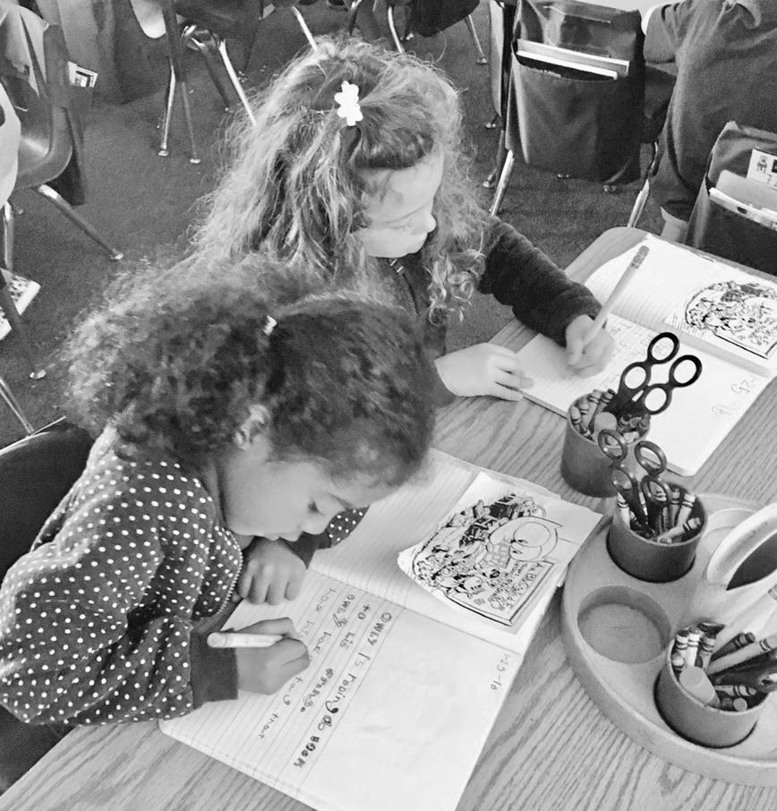
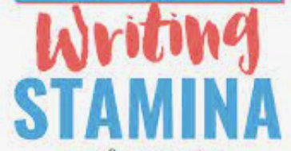
Power Writing:
A Fluency Strategy

Slide 5
Power Writing
BRAINSTORM & PARTNER TALK

Slide 6
Mantra:
“I am a writer! I am a powerful writer! I will write as much as I can, as well as I can, as fast as I can until the time is through!”

Slide 7
Power Writing
Write!

Slide 8
Power Writing
Magic Headphones & Word Count

Slide 9
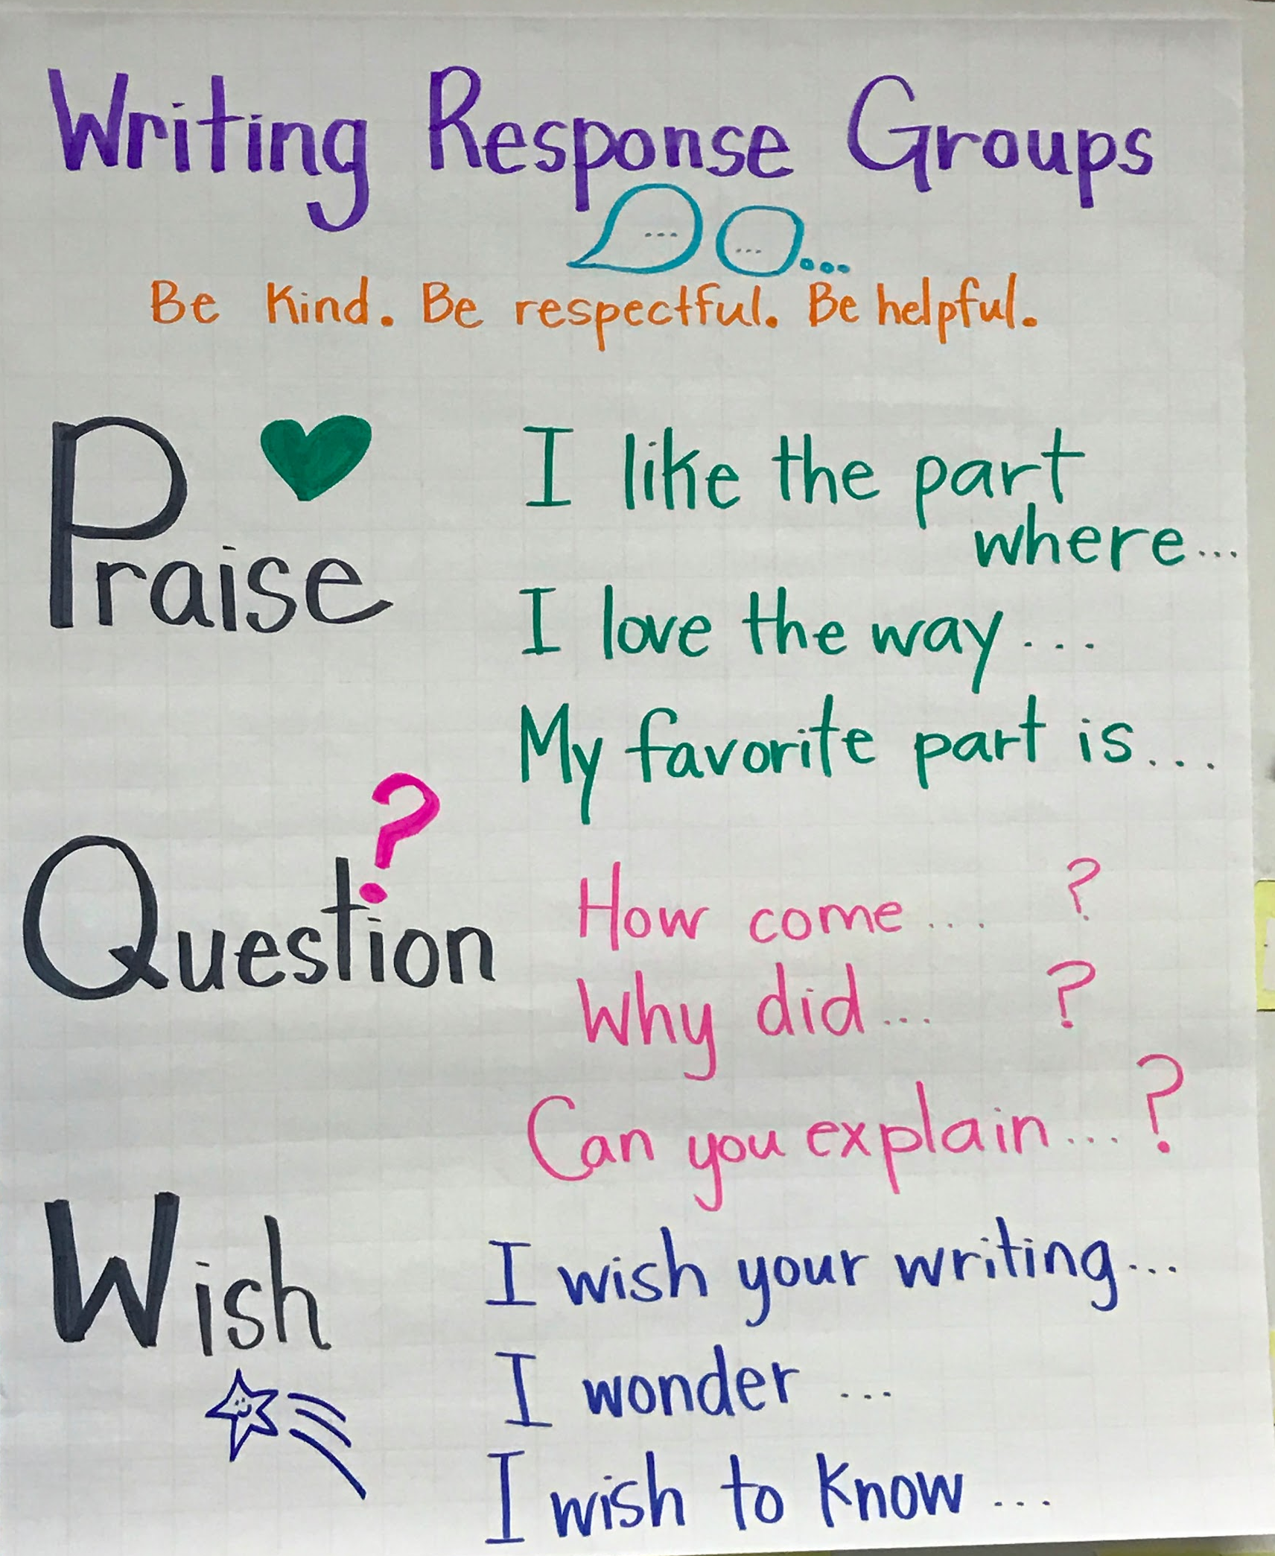
Power Writing
Sharing & Feedback

Slide 10
Power Writing
Sharing & Feedback

Slide 11
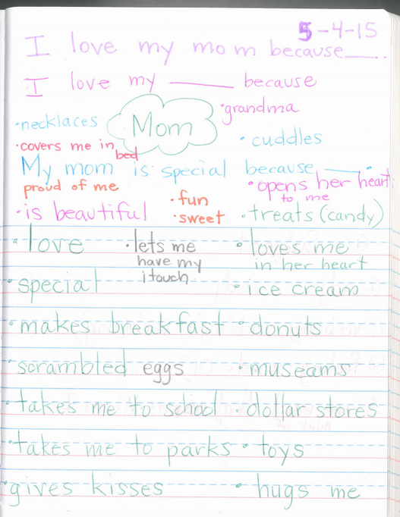
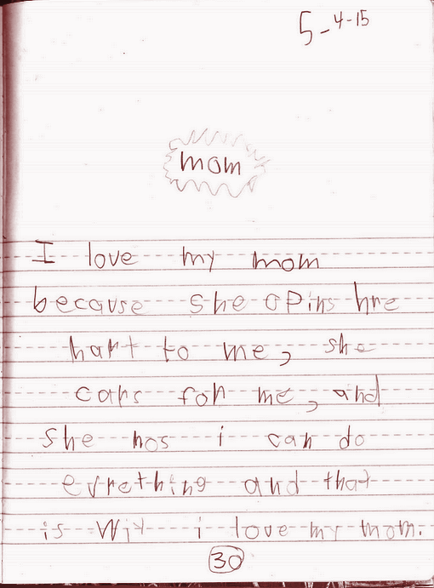
KINDERGARTEN SAMPLES

Slide 12
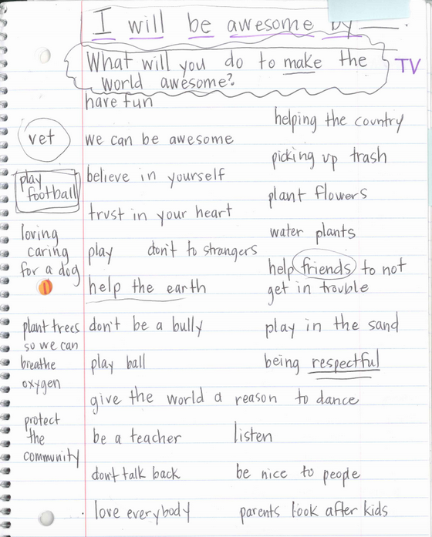
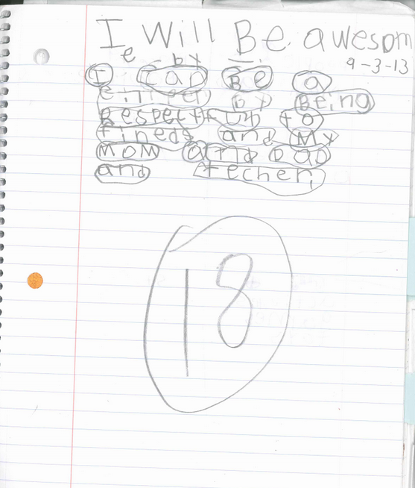
FIRST GRADE

Slide 13
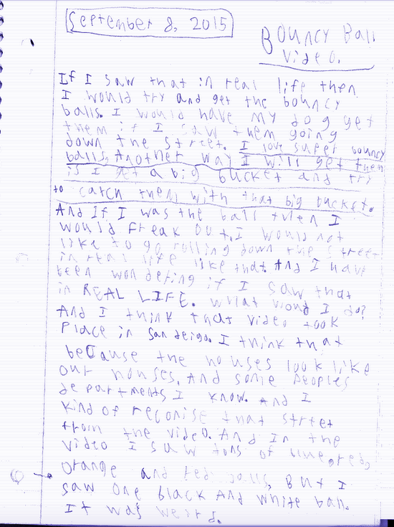
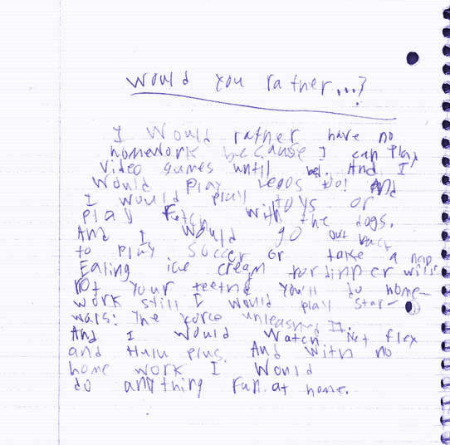
THIRD GRADE SAMPLES

